Slide 1
Syntax & Songbirds
a duet for avian vocal synthesizer and oboe
Kyler Brown, PhD candidate, Committee on Computational Neuroscience
Geoff Brookshire, PhD candidate, Psychology
Marcelle Pierson, PhD candidate, Music History and Theory

Slide 2
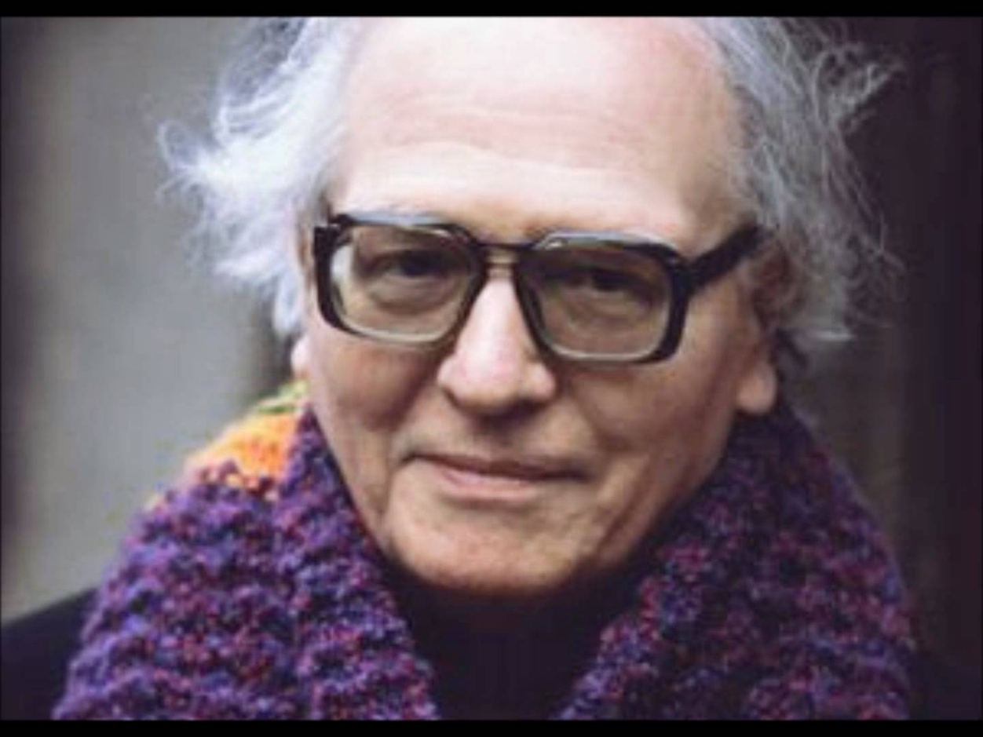

Birds in composition
Olivier Messiaen (1908-1992)
Quartet for the End of Time, Mvt. 1

Slide 3
